Slide 1

Car Dealership Project
Course Project
By: Bozhidar Mindov
COS221a
Professor: Vladimir Georgiev

Slide 2

Main Idea
Make a functional sorting and lookup program that could be used by real dealerships.
The program reads vehicle data from a file, creates vehicle objects with the data and places them into a collection.
The end user has the option to sort that collection by the total price, warranty or insurance of the vehicle.
The user also has the option to look for vehicles in the collection by providing their brand or model.

Slide 3
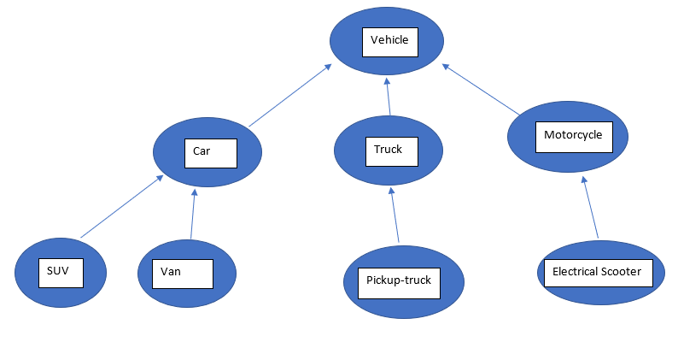
Class Hierarchy

Slide 4

Polymorphic Methods
virtual int CalculateWarranty() = 0; - calculates and return’s the vehicles warranty in years.
virtual double CalculateTotalPrice() = 0; - calculates and returns the total price of the vehicle
virtual double CalculateInsurance() = 0; - calculates and returns the monthly insurance payments for the vehicle
virtual void DisplayInfo() = 0; - displays information about the vehicle
Methods used in the pattern matching method of the main function (driver program):
virtual string getBrand() = 0; - returns the brand of the vehicle.
virtual string getModel() = 0; - returns the model of the vehicle.

Slide 5

Algorithms Used
Merge Sort:
- It is used to sort the collection of vehicles.
- The user can choose how the collection should be sorted – by total price, warranty or insurance.
Boyer-Moore Pattern Matching Algorithm :
- The program allows to user to search for a brand or a model of a vehicle in the collection.
- The BM pattern matching algorithm is used to look for such matches.

